Slide 1
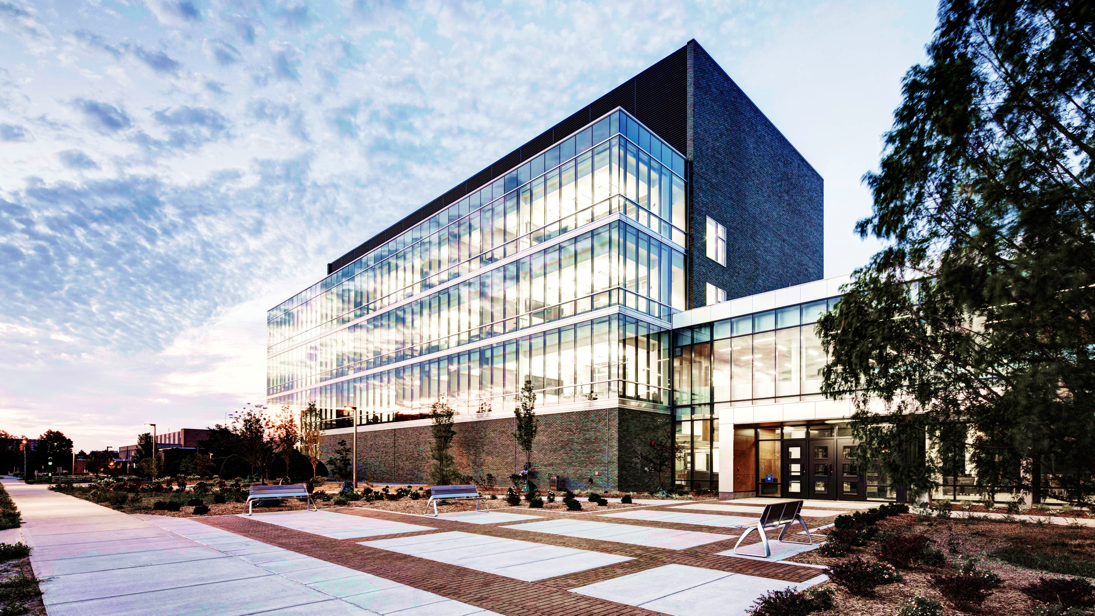
Molecular Plant Sciences Graduate Program
Notes:
Image: Molecular Plant Sciences building
Credit: ©2012 Jim Haefner
DESIGN GUIDELINES
Text
Font: Helvetica
Secondary font: Calibri used in colored boxes and infographic-style text, for better legibility
Title color: #404040 (grey)
Body color: #595959 (grey)
Bold font color: #B24E23 (burnt orange)
Color on dark background: #FFFFFF (white)
Color on light background: #000000 (black)
Usage specs:
Capitalize first letter of each word in titles
Capitalize first letter for each bullet point in content areas
Capitalize first letter after a colon in content areas
Capitalize all letters in section headers
No periods at the end of bullet points, even if full sentences
Color Palette
MPS Primary color: #18453B (MSU green)
MPS Secondary accent color: #B24E23 (burnt orange)
Dark background color: #404040 (grey)
Design elements
Circle as thematic point of focus. It is the main design element and is used on all slides. Examples of usage:
Half-circle in the bottom-right of footer to highlight slide numbers (ex: slide 2)
Full circle as a backdrop for titles in section header slides (ex: slide 3)
Full circles used for images (ex: slide 8 or slide 12)
Full circles used for shapes (ex: slide 6)
Straight line is a secondary design element. It is used to delineate or highlight sections. Examples of usage:
Short line under titles in section header slides (ex: slide 3)
Long line at the bottom of the slide to delineate the footer area (ex: slide 2)

Slide 2
MPS // Presentation Outline
Program Overview: Why, what, who, how
Program Details: Educational objectives, curriculum, student experience
Joining MPS: Application process, requirements
Program Contacts

Slide 3
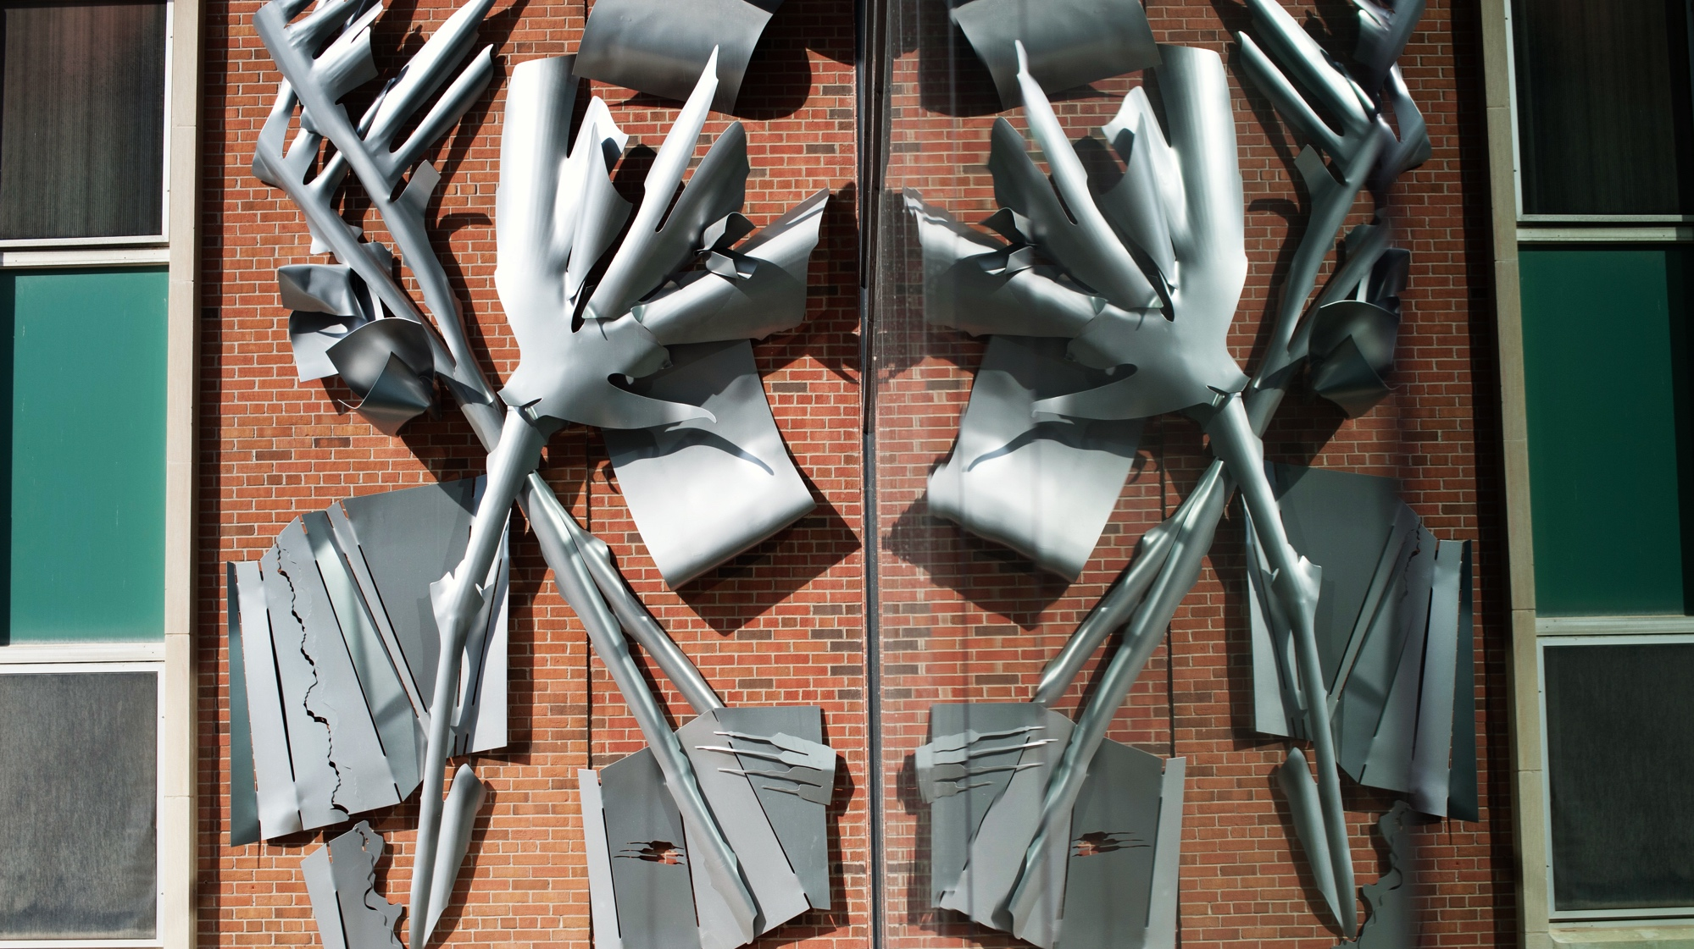
PROGRAM
OVERVIEW
Notes:
Image: Molecular Plant Sciences building interion
Credit: Kurt Stepnitz, ©2012 Michigan State University Board of Trustees

Slide 4
MPS // Why: The Purpose
Overview: MSU has one of the world’s highest concentration of molecular plant scientists, with over 50 faculty in eight departments and two colleges
Vision: To bring together the breadth and depth of MSU molecular plant sciences faculty under one program
A portal cutting across departments and providing access to over 50 faculty
Integrative and technologically adaptive curriculum to train the next generation of plant scientists
Common, essential knowledge-base to face 21st century global challenges
Mission: To provide a modern education in molecular plant sciences, leading to the PhD degree

Slide 5
MPS // What: New Graduate Program
Dual major graduate program leading to the PhD degree
First student cohort started during Fall 2018
MPS admits 10 students per year; up to 50 students by year 5
Students are members of both the MPS program and one of the participating degree-granting departments or programs at MSU
First-year core courses provide unified and rigorous education in modern plant molecular sciences
MPS Website (https://mps.natsci.msu.edu/)

Slide 6


MPS // Who: Participating Programs
Biochemistry and Molecular Biology
Cell and Molecular Biology
Entomology
Genetics
Horticulture
Plant Biology
Plant, Soil, and Microbial Sciences
Statistics and Probability

Slide 7
MPS // How: Core Courses
Two new first-year core courses tie the program together
PLB/BMB 856: Plant Molecular and Omics Biology
BMB/PLB 866: Molecular Plant Physiology

Slide 8
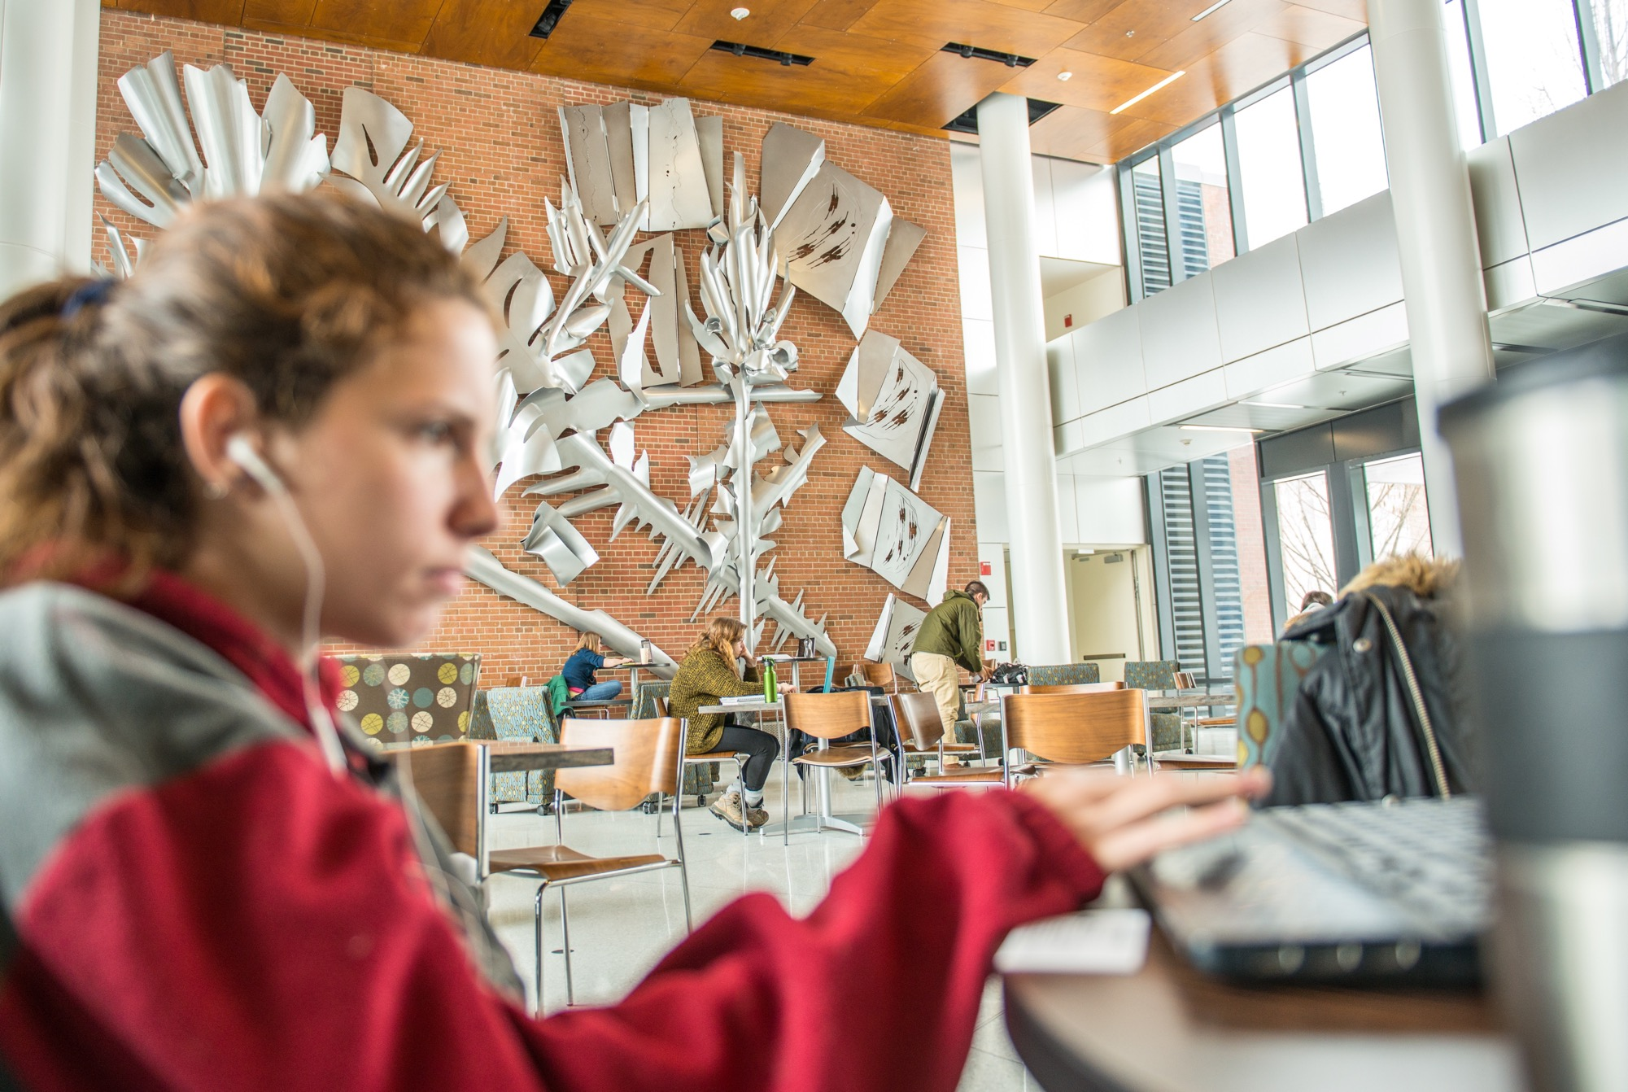
PROGRAM
DETAILS
Notes:
Image: Molecular Plant Sciences building interion
Credit: Kurt Stepnitz, ©2012 Michigan State University Board of Trustees

Slide 9
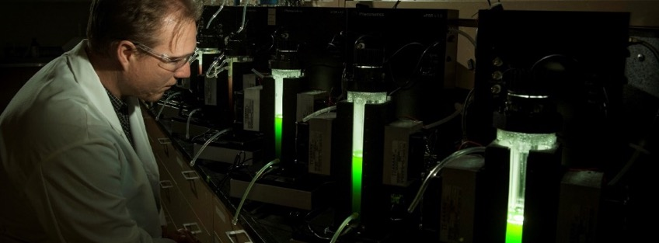
MPS // Educational Objectives
Comprehensive, integrative understanding of the molecular processes underlying:
Plant energy status
Metabolism
Growth
Development
Gene regulation and evolution
Plant stress tolerance
Interaction with the environment

Slide 10
MPS // Educational Objectives: Competencies
Molecular, biochemical, physiological, cell biological, genetic, genomic, computational, and data-science approaches to scientific discovery
Hypothesis development and hypothesis testing

Slide 11
MPS // Educational Objectives: Skills
Critical and creative thinking
Reading and evaluation of primary literature
Writing of proposals and manuscripts
Oral presentation
Classroom teaching
Communication with scientific and lay audiences

Slide 12
MPS // PhD & Research Timeline
Typical PhD timeline
Year 1: MPS core courses and electives, three to four eight-week rotations
Year 2: Electives, guidance committee assembled, begin research
Years 3 - 5: Research phase
Year 5: Finish research, write and defend dissertation, graduate
Dissertation represents original research and must be approved by committee
Final oral exam to defend research

Slide 13
MPS // Typical PhD Timeline (alternate)
Year 1
Year 2
Years 3 - 5
Year 5
Core courses
Electives
Three to four eight-week rotations
Electives
Guidance committee assembled
Begin research
Research phase
Finish research
Write and defend dissertation
Graduate

Slide 14
MPS // Core Courses
PLB 856/BMB 856. Plant Molecular and Omics Biology
Topic areas:
BMB 866/PLB 866. Molecular Plant Physiology
Topic areas:
Genetics, genomics, chromosome structure, transcriptional and post-transcriptional regulation, proteomics, plant transformation and genetic engineering, plant signaling
Photosynthesis, primary metabolism, lipids, cell walls, water relations, long distance transport, mineral nutrition; Some of these topics have been moved from BMB/PLB 864, which will be significantly revised - others will be new

Slide 15
MPS // Courses
Computational/quantitative biology requirement, one of:
PLB 812. Principles and Applications of Plant Genomics.
CMSE 890. Modular bioinformatics course(s) (3 credits), under development by CMSE
One elective course – Examples include:
PLB/HRT 865. Plant Growth and Development
PLP 881. Molecular and Biochemical Plant Pathology
BMB 805. Protein Structure Design and Mechanisms
BMB 829. Methods of Macromolecular Analysis and Synthesis
BMB/PLB 864. Plant Specialized Metabolism
HRT 863. Environmental Plant Physiology
NSF-NRT Program: Offers courses connecting plant and computational sciences
Notes:
Computational requirement is a key element of the new program that is not currently required of most plant molecular students but needs to be to prepare them for 21st century plant science. This is part of what distinguishes MPS from existing programs.
Seminar requirement might be fulfilled by seminars in other programs. The dual major programs are likely to have their own seminar requirements. We don't want students to have to take five or six seminars to fulfill the requirement.

Slide 16
MPS // Graduate Seminars
Three graduate seminar courses
Led by MPS faculty
Topic-based seminar courses drawing on primary literature in plant molecular and systems biology
Broader skills development: Oral presentation and critical analysis of primary literature. Topics vary each semester, may be suggested by students or faculty, and are approved by the MPS executive committee
Notes:
Computational requirement is a key element of the new program that is not currently required of most plant molecular students but needs to be to prepare them for 21st century plant science. This is part of what distinguishes MPS from existing programs.
Seminar requirement might be fulfilled by seminars in other programs. The dual major programs are likely to have their own seminar requirements. We don't want students to have to take five or six seminars to fulfill the requirement.

Slide 17

MPS // Professional Development
Skills:
Resume writing
Interviewing
Poster presentation and networking at scientific meetings
Web representation
Imparted through courses and activities (ex: grad student seminars)
Some offered by the primary (dual) graduate programs

Slide 18
MPS // Monday Seminar Series
Hosted by MPS (link)
Weekly during fall and spring semesters
Visiting speakers:
Address timely research topics
Visit MPS labs to meet students, postdocs, and faculty in an informal setting

Slide 19
MPS // Student Community
Association for Molecular Plant Science Students (AMPSS): New MPS student group
Philip Engelgau, President (engelga2@msu.edu)
Fascination of Plants Day: Scientist-run event to share plants knowledge with the general public (link)
Unofficial Grad Guide: For more student activities (link)

Slide 20
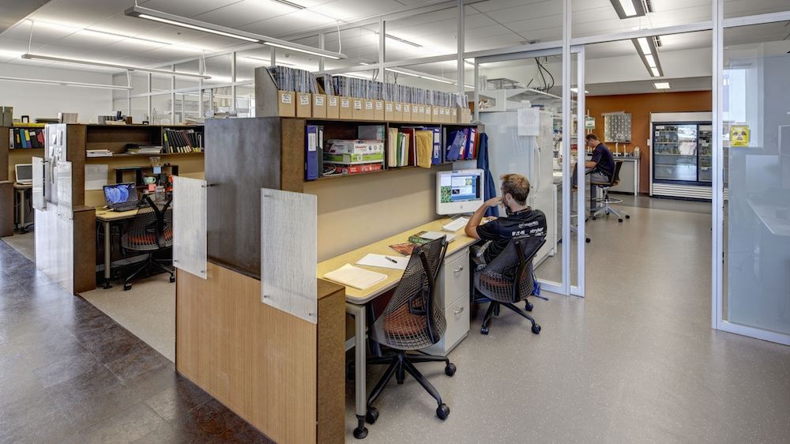
JOINING
MPS
Notes:
Image: MPS Laboratory
Credit: ©2012 Jim Haefner

Slide 21
MPS // Application Process
Two-part application
1) MSU application form to the dual department of choice
2) MPS application form and one-page description of interest in MPS program
Apply by one of two routes
a) Preferred route: Submit both MSU application and MPS application and one-page description via MPS website
b) Students who have already applied to a dual department and that are made aware of MPS would submit the one-page form separately on MPS website
Notes:
MPS will forward all application materials to the dual major program as they are received. Important to make sure people know that applications submitted through MPS will be able to receive full and timely consideration by second program. Student may be accepted by second program even if not accepted by MPS.

Slide 22
MPS // Admission Requirements
Appropriate background in biology, chemistry, physics, mathematics, and/or computer science
Minimum undergrad GPA of 3.0 in relevant science courses
In special cases, an applicant who has deficiencies in background courses may be admitted on a provisional basis

Slide 23
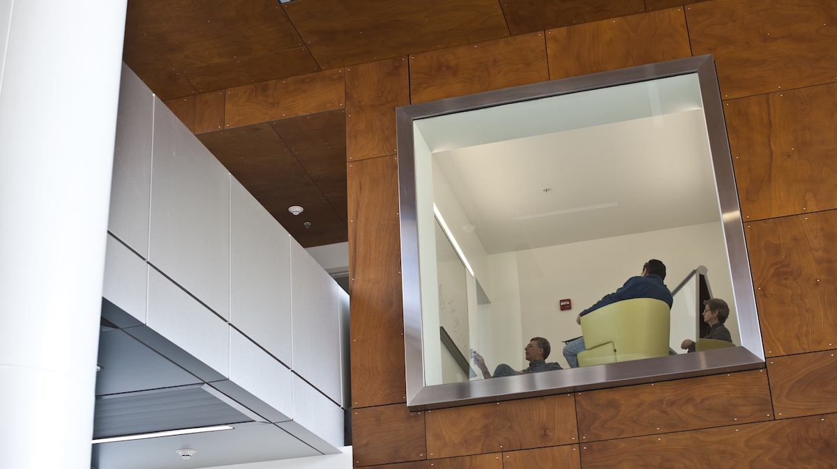
PROGRAM
CONTACTS
Notes:
Image: Molecular Plant Sciences building interion
Credit: Kurt Stepnitz, ©2012 Michigan State University Board of Trustees

Slide 24
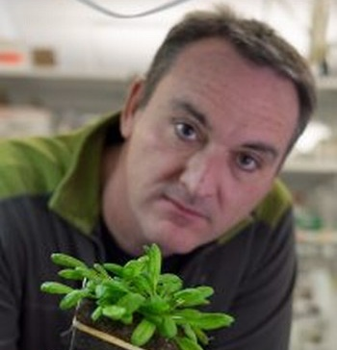
Brad Day
Director
bday@msu.edu
(517) 353-7991
MPS Building, Room 4200
When to contact: forming guidance committee, major exceptions

Slide 25
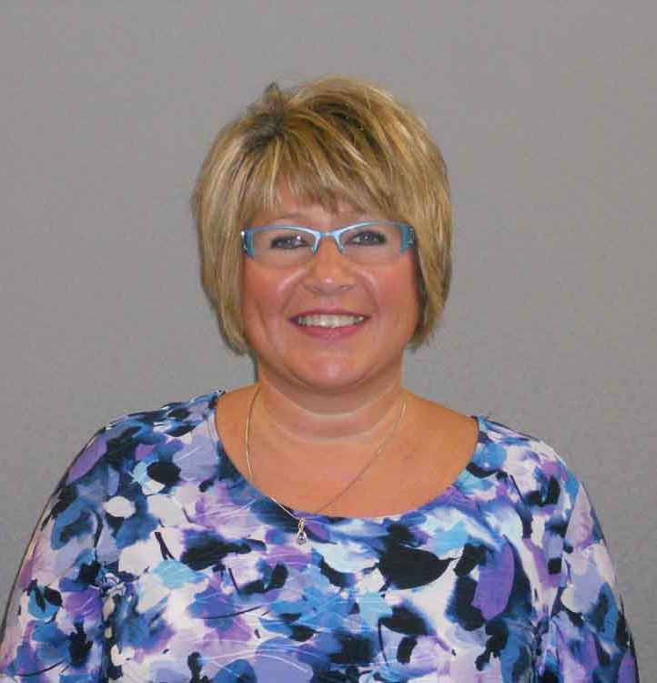
Carol Wood
Graduate Secretary
woodc@msu.edu
(517) 432-0776
Plant Biology Laboratories, Room 106
When to contact: tracking course completion, filling out forms

Slide 26
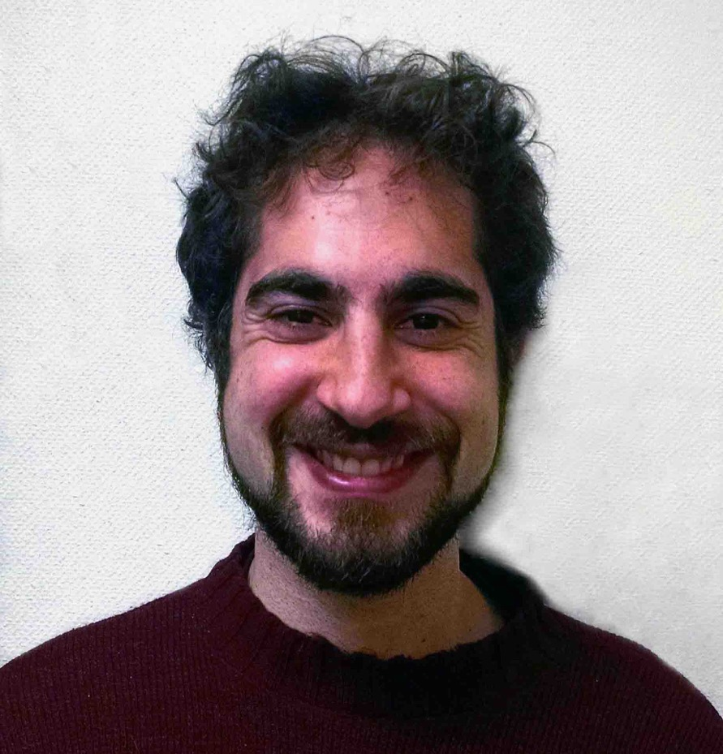
Igor Houwat
Communications Coordinator
houwatig@msu.edu
(517) 353-2223
Plant Biology Laboratories, Room 105B
When to contact: new publications, awards, notable news for web publication

Slide 27
MPS // Executive Committee
Director: Brad Day
Committee members
Christoph Benning
Dean DellaPenna
Rebecca Grumet
George Sundin
Curtis Wilkerson

Slide 28
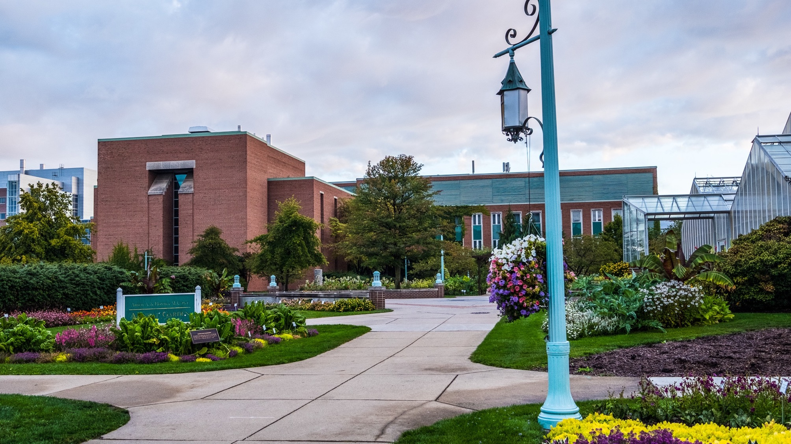
QUESTIONS?
mps.natsci.msu.edu
Notes:
Image: Plant Biology Laboratories
Credit: Kurt Stepnitz, ©2017 MSU Board of Trustees

